Slide 1

HR Recruitment Data
Analysis
Presented by: Rowthu Bhulakshmi Course: B.Tech CSE
College: Avanthi Institute of Engineering and Technology
Project Type: Minor / Internship Project Technology: Java, CSV File Handling

Slide 2

Agenda:
To read and process HR recruitment data from a CSV file using Java
To analyze candidate information such as department, selection status, and salary
To calculate total number of candidates, selected candidates, and rejected candidates To perform department-wise analysis of job applications
To compute average salary offered to selected candidates
To generate meaningful insights from raw HR data for decision-making
To demonstrate data handling and basic analytics using Java programming

Slide 3
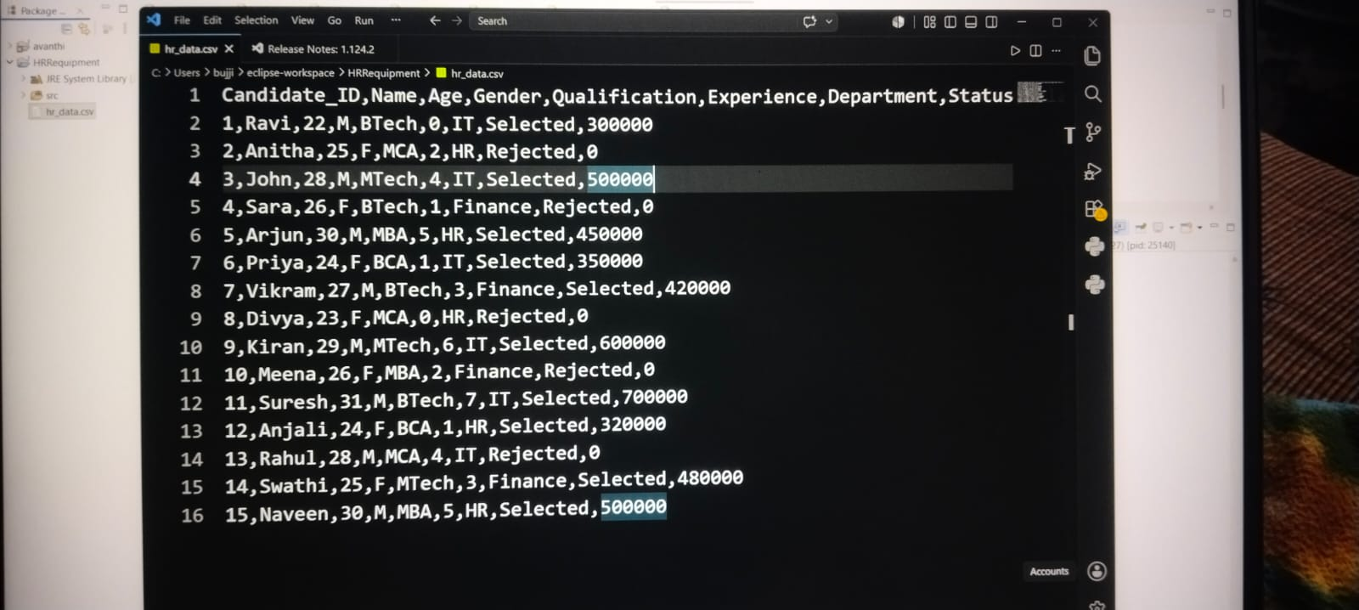
project overview:
Their analysis provides clarity in situations where uncertainty previously existed
1
Reads HR recruitment data from a CSV file using Java
2
Processes candidate details such as department, status &salary
3
Calculates total, selected, and rejected candidate counts
4
Performs department-wise recruitment analysis
5
Generates insights to support HR decision-making

Slide 4
Objectives:
1
Data Processing
Data Processing is Read and process recruitment data from the CSV file.
2
Candidate Analysis
Calculate the total number of candidates in the dataset.
3
Hiring Status
Determine the number of selected and rejected candidates.
4
Department Analysis
Analyze applications received from different departments.
5
Salary Analysis
Calculate the average salary offered to selected candidates.

Slide 5
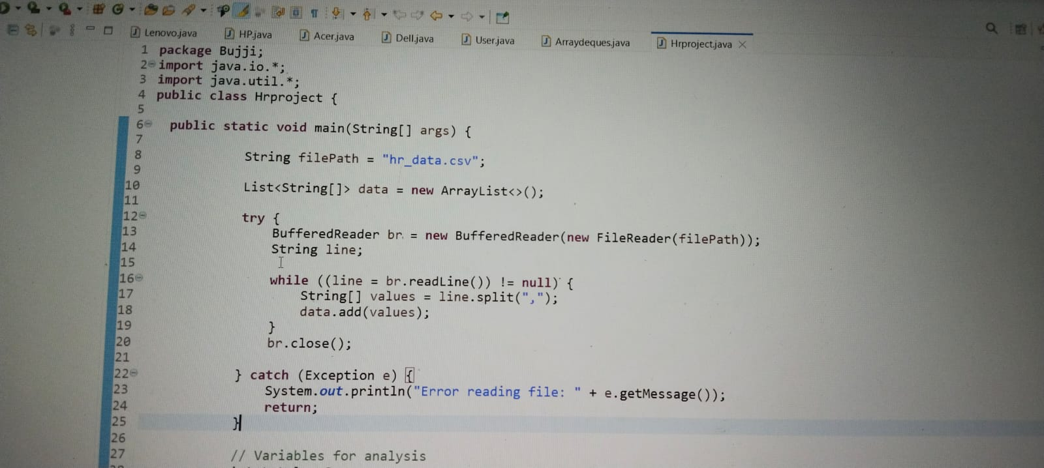
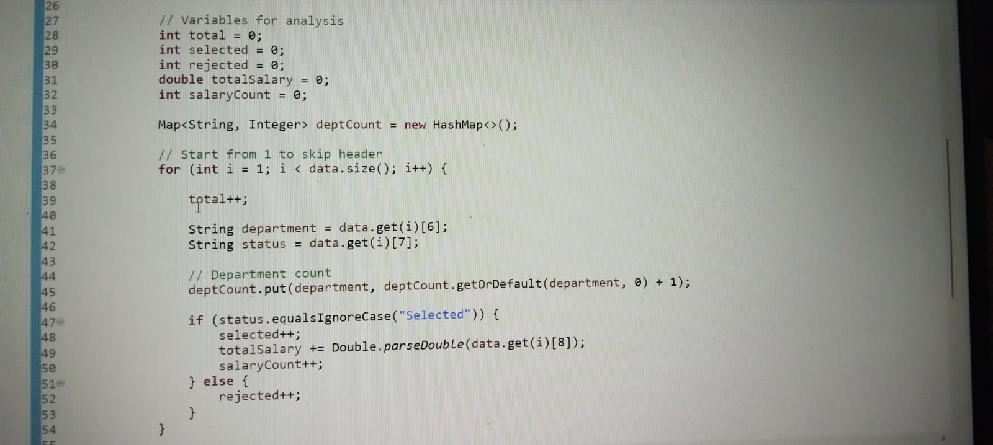
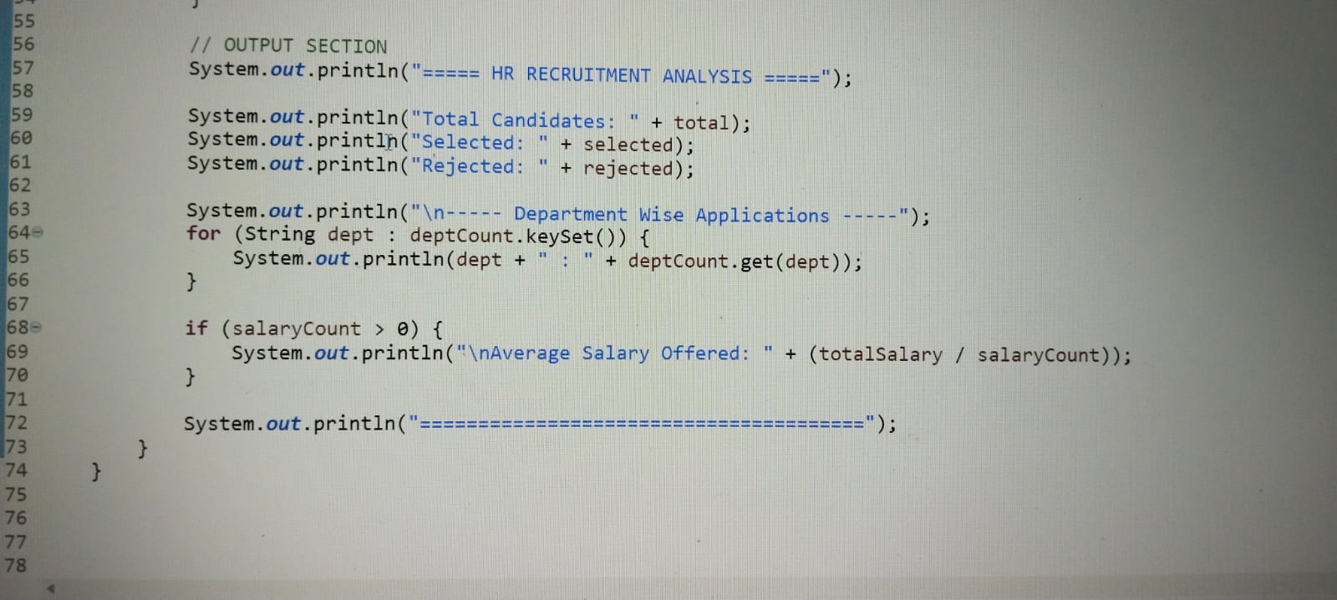
Program code:

Slide 6
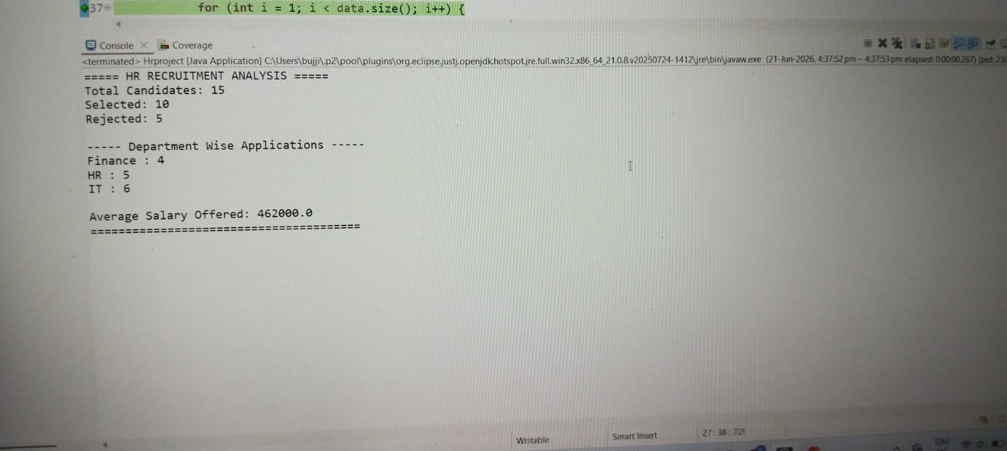
Methodology / Analysis & Results:
Read data from CSV file
Process candidate records using Java
Count total, selected, and rejected candidates
Analyze department-wise applications using HashMap
Calculate average salary of selected candidates
Display results
Page 6

Slide 7

Thank You
Page 7

